Slide 1
Grades Analysis & Predictions
Anthony Tran, James Nguyen, Martin Nguyen
CS 122
November 30, 2021
Notes:
Hi everyone, im james and i’m here with anthony and martin today we will talking about grades analysis and predictions. As college student we always wonder what variables impact how we academically perform as we always are striving to improve ourselves. So for this presentation, we want to explore the different impacts on a student’s academic performance, and whether we can utilize these different features to predict a student’s grades.

Slide 2

Agenda
Dataset Background
Student’s Personal Life versus Academic Performance
Student’s Social Life versus Academic Performance
Building & Testing Three Different Prediction Models
Challenges & Improvements
Source: http://clipart-library.com/student-planner-cliparts.html

Slide 3

Student Alcohol Consumption Dataset
Can be found at https://www.kaggle.com/uciml/student-alcohol-consumption
Dataset focuses on Math grades for two high schools in Portugal
G1, G2, G3; totalGrade
First, second, third period grade from 0-20
totalGrade: average % from 0-100
studytime
Weekly study time rated from 1-4
Medu, Fedu
Mother and Father education levels respectively from 0-4
Failures
Number of past class failures from 0-3
Dalc, Walc
Workday alcohol and Weekend alcohol consumption respectively from 1-5
goout
Time spent going out with friends from 1-5
Source: https://www.subpng.com/png-rwo4v7/
Notes:
studytime:
1: 2- hrs
2: 2-5 hrs
3: 5-10 hrs
4: 10+ hrs
Medu, Fedu:
0: none
1:elementary school
2: middle school
3: high school
4: college

Slide 4
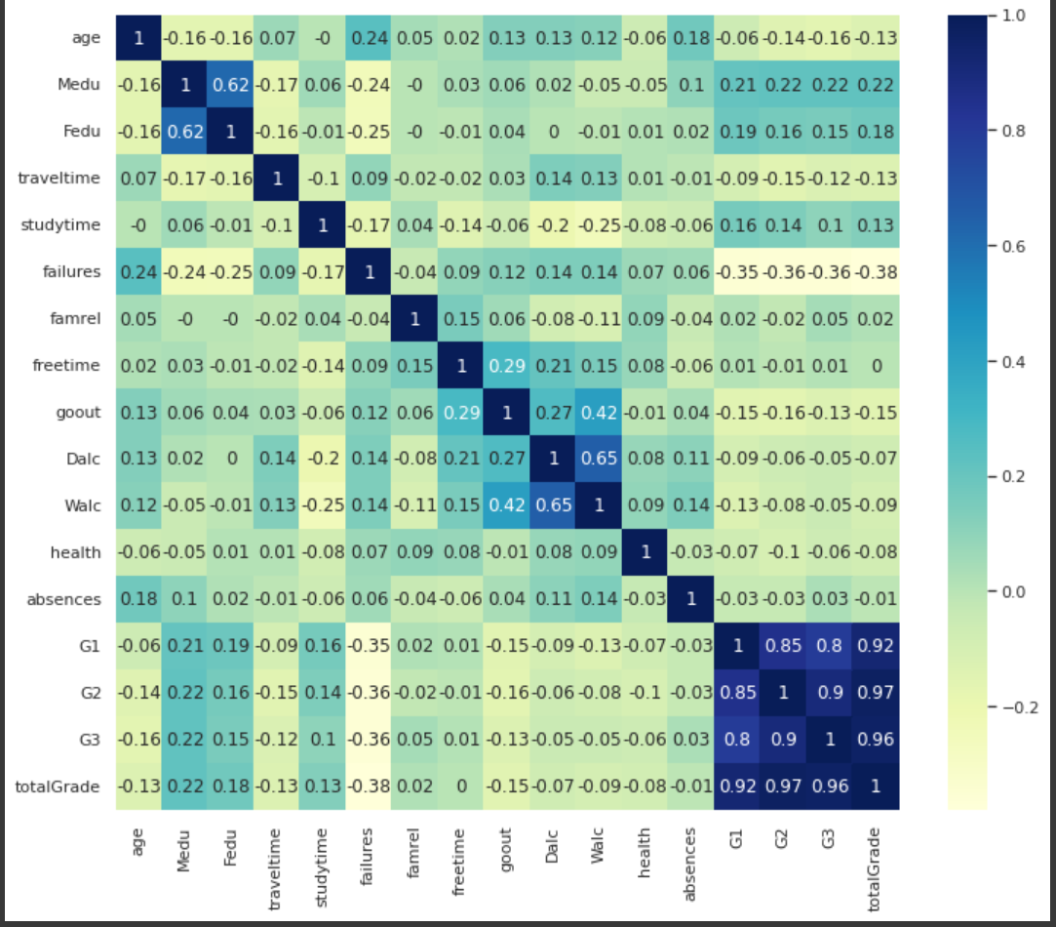
Dataset Heatmap
Positive Correlation:
G1 and G3 (0.8) & G2 and G3 (0.85) & G1 and G2 (0.9)
Dalc and Walc (0.65)
Fedu and Medu (0.62)
Walc and goout (0.42)
Dalc and goout (0.27)
...
Negative Correlation:
G1, G2, G3, and failures (-0.35, -0.36, -0.36)
Walc and studytime (-0.25)
Medu and failures (-0.24)
...

Slide 5
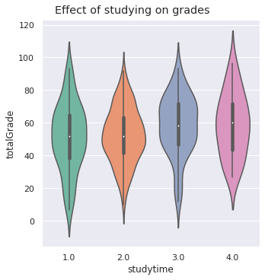
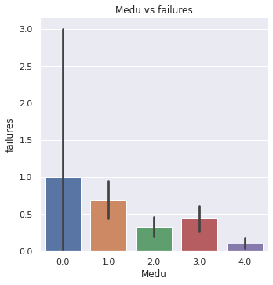
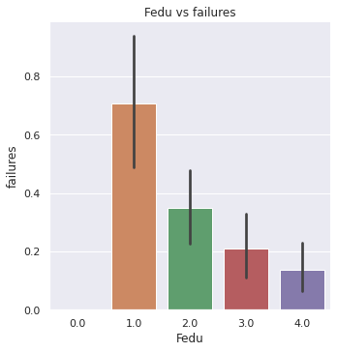
Personal Life Versus Academic Performance
Notes:
Studying: studying had a very minor correlation with grades. It was most apparent in the first period (G1), but not by much.
Medu and Fedu vs Failures: Higher education level meant less failures

Slide 6
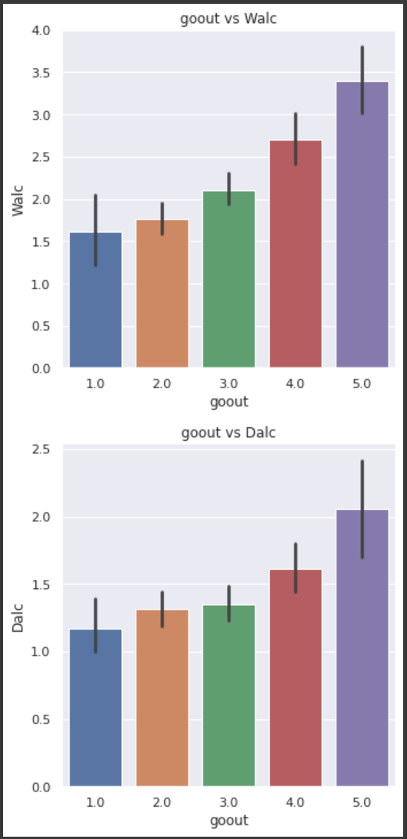
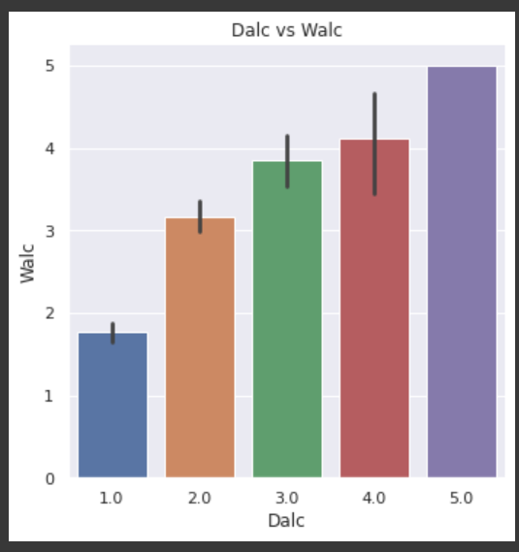
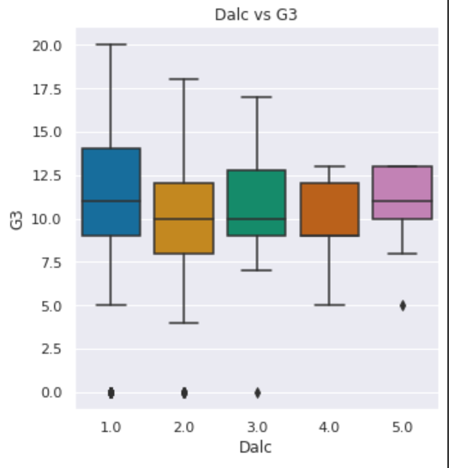
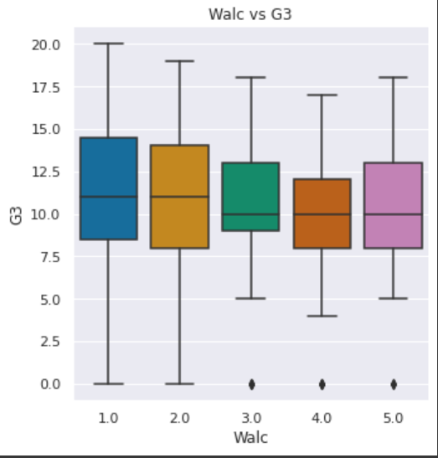
Social Life Versus Academic Performance
goout vs Walc (0.42)
goout vs Dalc (0.27)
Dalc and Walc (0.65)

Slide 7

Predictive Modeling
Regression Problem
Three Models
Linear Regression
Finds Linear Function which best fits the data
Decision Tree Regressor
Create a continuous variable Decision Tree
Support Vector Regression
Finds Hyperplane that fits the most number of points
Dataset is split into 20% Testing and 80% Training
Should G1 and G2 scores be included in the input variables?
Notes:
With the data analysis done, we can now move on to building three different predictive models which will be able to predict the final grades of students. Since the model needs to predict final grades which are continuous numerical values, the problem needs regression models to solve it. We decided to choose the following models:
Linear Regression - Model which finds a linear function that best fits our training data. This function will be used to determine the final grades.
Decision Tree Regressor - Model which creates a continuous variable decision tree based on our training data that will be used to decide the final grade.
Support Vector Regression - Model which finds a hyperplane that fits the most number of points in our training data. The goal of SVR is to minimize the amount of error but also maximize the margin of the hyperplane.
We also decided to split the dataset into 20% Testing and 80% Training, and have our output variable as G3, the final score.
However with the input variables we faced a dilemma of whether we should include G1 and G2 scores.
Based on previous observations, there are low correlations between variables so there may b poor performance from our models if we didn’t include the scores.
However, if we were to include G1 and G2 scores, this can cause model variance which is when the model will fit the training data well, but not the test data since the grades can be too specific per student.

Slide 8
Cross Validation Scores of Including & Not Including
Cross Validation gives us insight how well our model is performing
Splits training data in X parts
For each part, the model will be trained based on all the training data except for that part
Remaining Part use to validate the model
Based on the average cross validation scores, including G1 and G2 increases Model Performance
Cross Validation Average Scores
 | LR | DTR | SVR
Without G1 & G2 | -0.01 | -0.5 | -0.05
With G1 & G2 | 0.80 | 0.78 | 0.81
Notes:
We used a machine learning technique called cross validation to give us insight how well our models are performing with and without G1 & G2 scores. Cross Validation works by splitting the training data into 5 parts, and for each part the model will be trained based on all the training data except for that part. That remaining part will be then used to validate the model which returns a score out of 1 of how well the model performing. Based on these average scores we can see that if we didn’t include G1 and G2 scores, the models have terrible performance. But by including them, we can see that we are getting very decent scores. So that’s why we decided to train our model with G1 and G2 scores included in the input features.

Slide 9
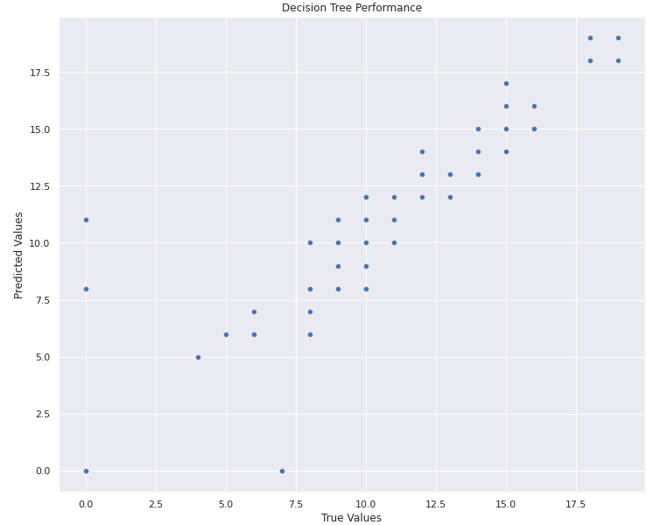
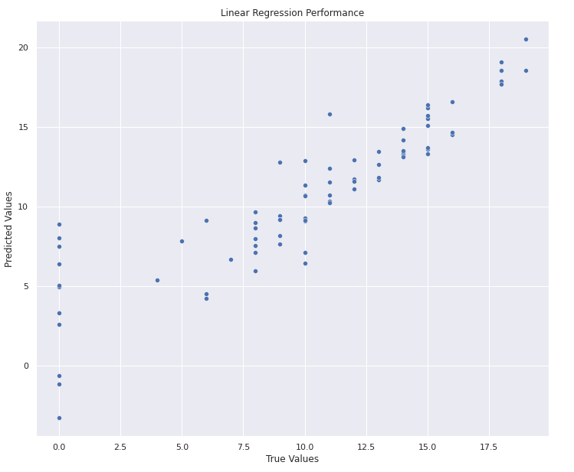
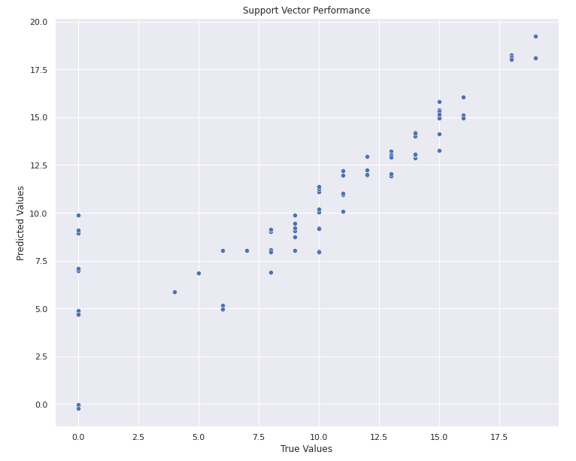
Which Model Performs the Best?
Notes:
With the models trained, we then inputted our testing data and received the following results. The x-Axis is the True values, while the y-axis is the predicted values. We can see that all models perform very well as the predicted values are very close with the actual value. We can also see that the all the model struggled with predicting grades of 0. However, solely based on these graphs, we still can’t tell which model is the best so we decided to look at some other metrics.

Slide 10
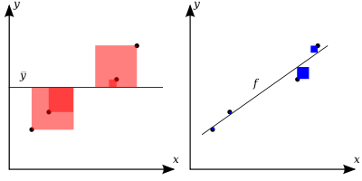
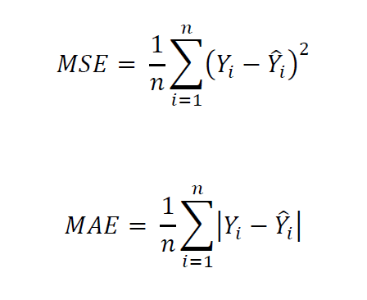
Which Model Performs the Best?
Evaluate the Model with Three Metrics
Coefficient of Determination (Also known as R Squared Value)
Percentage of how close the predicted data fits to the true values
Mean Squared Error
Average of the Squares of the Difference between predicted & true values
Penalizes Big Errors
Mean Absolute Error
Similar to Mean Squared Error but takes absolute value of the difference
Source: https://en.wikipedia.org/wiki/Coefficient_of_determination
Source: https://econbrowser.com/archives/2019/07/thems-fightin-words-futures-mean-squared-error-mean-absolute-error
Notes:
We decided to use the following metrics to evaluate the model based on its performance on our testing data:
Coefficient of Determination: shows the percentage of how closed the predicted data fits to the true values.
Mean Squared Error: shows the average of the squares of the differences between the predicted and true values. The metric gives large penalizations to errors since it takes the squares of the errors.
Mean Absolute Error: similar to mean squared error but instead of the square of the difference, the metric takes the absolute value of the difference. Unlike Mean Squared Error, the metric does not give large penalizations and treats all errors as the same.

Slide 11
Which Model Performs the Best?
Linear Regression Model performs a bit better than the other models
The Model had the highest R Squared score
The Model did have a high absolute error, but errors were not as severe
Model Performances
Model | CoD | MSE | MAE
LR | 0.7881 | 5.845 | 1.610
DTR | 0.776 | 6.19 | 1.203
SVR | 0.779 | 6.087 | 1.203
Notes:
Based on these performances we can conclude that although all models perform very well, the Linear Regression Model seems to be performing a little better than the other models. The model performances on our testing data showed that the Linear Regression model had the highest R squared score which means that it was the most accurate. Furthermore, even though the Linear Regression Model did have the highest absolute error, the model’s errors were not as severe as the other model’s errors which can be seen in the models low mean squared error.

Slide 12

Challenges & Improvements
Creating Interesting Visual Plots
Little Knowledge of Machine Learning
Low Correlations of Variables with Final Grades
Source: https://www.tiempodev.com/blog/software-development-issues-and-challenges/
Notes:
Only really used boxplots, barplots, and violin plots due to categorical nature of the dataset.
Come in with more ML knowledge
Find different data set, or combine dataset with portuguese dataset since low sample size and low correlations

Slide 13
Thank You
Questions?

